Slide 1
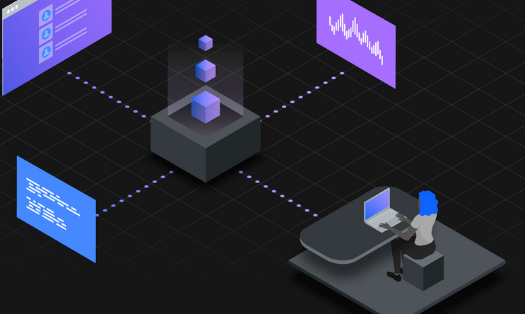
RPA Advanced: Bot Design and Reporting
Half day hands-on session
2 February 2022
(9:00AM - 12:30PM CEDT)

Slide 2
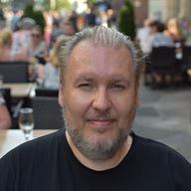
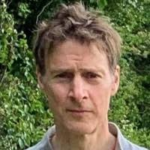
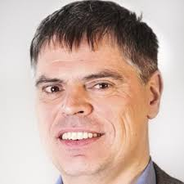
Team IBM for the event
Jukka
jukka.juselius@fi.ibm.com
Nigel
ncrowther@uk.ibm.com
Reinhold
r_engelbrecht@at.ibm.com

Slide 3
Agenda and schedule 09:00 – 09:05 Welcome 09:05 – 09-15 New features in RPA V21.0.2
09:15 – 10:00 Bot Design 10:30 – 11:15 Lab 1 – Bot Design 11:15 – 11:30 Reporting 11:30 – 12:15 Lab 2 – Reporting 12:15 – 12:30 Q&A and closing Master of lab image and Cloud environments - Jukka Time in CET https://time.is/CET All material: Training material

Slide 4
BP Workshop Wed, Date TBA Training material Please promote among the RPA partners you are working with!

